Slide 1
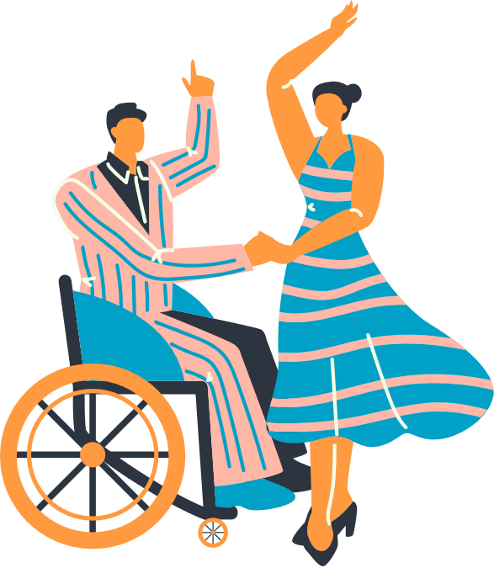
Virtual Community Mapping Workshop:
Connecting Transition-Age Students and Stakeholders with Community Resources, Services and Opportunities
Richard Chapman & Seb Prohn
Partnership for People with Disabilities
VCU School of Education
Notes:
Virtual Community Mapping Workshop: Connecting Transition-Age Students and Stakeholders with Community Resources, Services, and Opportunities

Slide 2

Today’s Agenda
Welcome & Introductions
Resource Mapping Experiences
Virtual Asset Mapping Overview
Jason’s map and experiences
Map Making!!

Slide 3
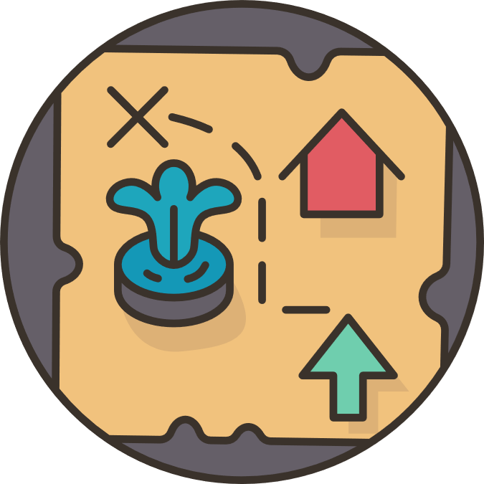
Why community maps? Why now?
Project PEACE
Community level
Virtual asset maps as part of a community landscape analysis.
Highlighting community wisdom
Where are resources?
How do support resource access?
Student level
Virtual asset maps to capture experiences, preferences and plans
Virginia Department of Education
Division-level maps
Developing resources to better connect students and their families to resources, services and opportunities in their communities.

Slide 4
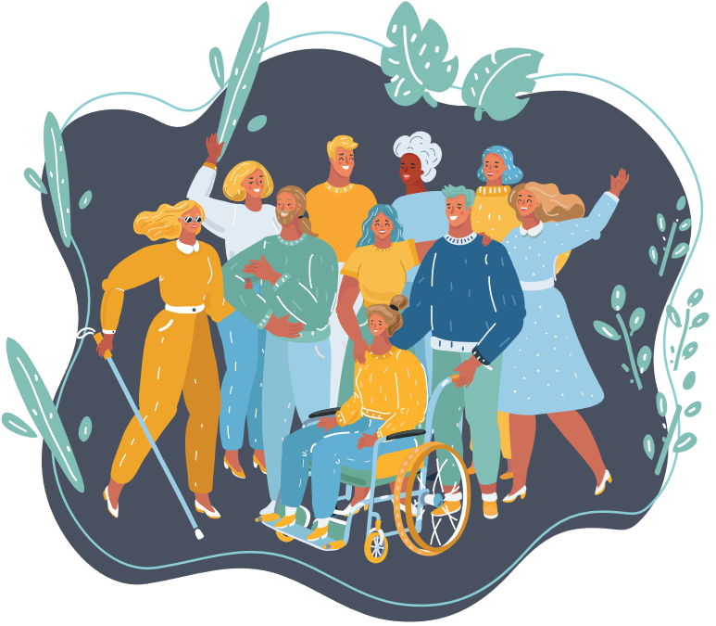
What are/were your experiences sharing community resources with students and families?
Pair up. Share up.
2 mins.

Slide 5

Mapping Foundations
Concepts and usage

Slide 6
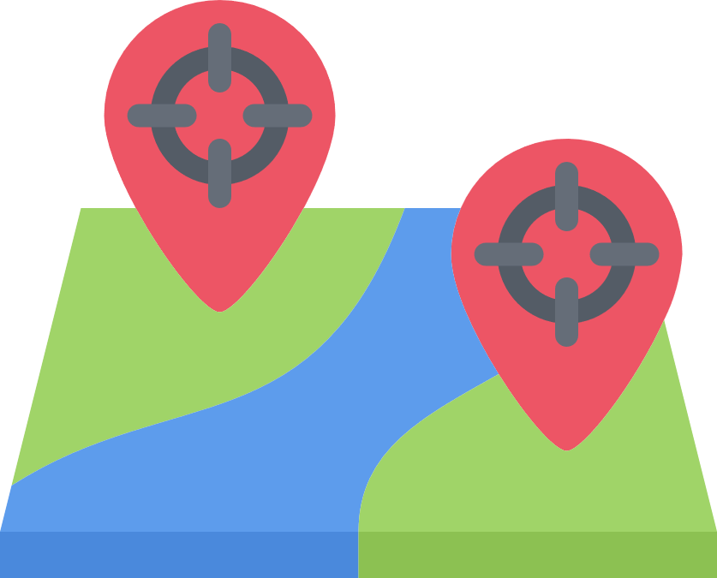
Transition & Asset Mapping
Community connections– opportunities, services, supports, etc– predict post-school success
We can foster collaboration–but we’ve got to be aware of resources!
Mapping can help!
Use maps to identify resources to address a pressing need. All communities have assets!

Slide 7
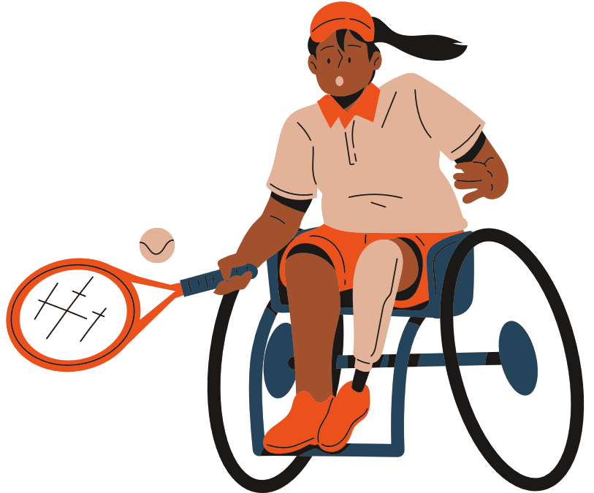
Person Centered
Gather information about community resources to support students (e.g., resources related to employment, postsecondary education, vocational training, transportation, independent living, leisure, health care, etc).
Use gathered information to identify specific opportunities and supports for students that match student interests, needs, and postschool goals.

Slide 8

Virtual Asset Maps
Customized virtual resources for students (and others!) as move from classroom to community to achieve their goals- including community participation and belonging
Living document -updated, added to and customized
Portfolio of experiences
  Where have they been?
  Where they want to go?
  Who and where are their supports?
  What are the paths for getting places?
Career exploration; community navigation tool but also for belonging and inclusion
Youth can take ownership- building maps and guiding IEP discussions
Consider using
http://mapstransition.com

Slide 9

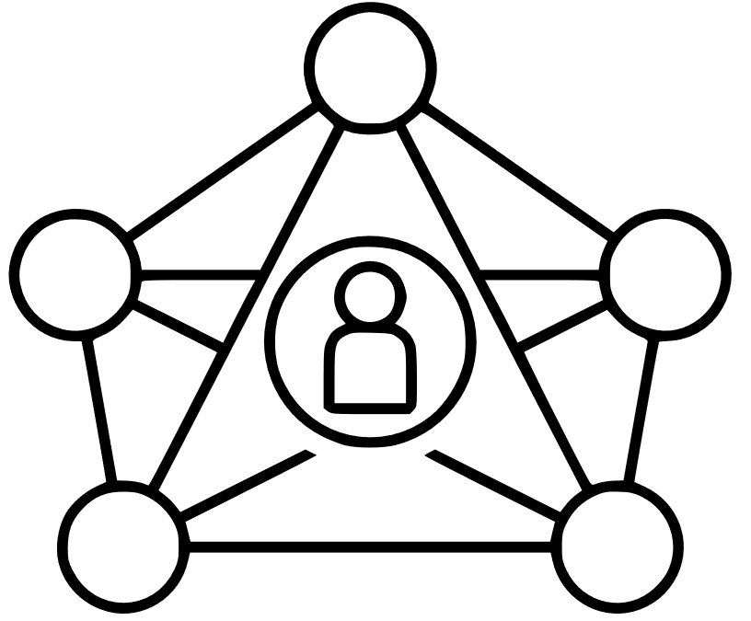
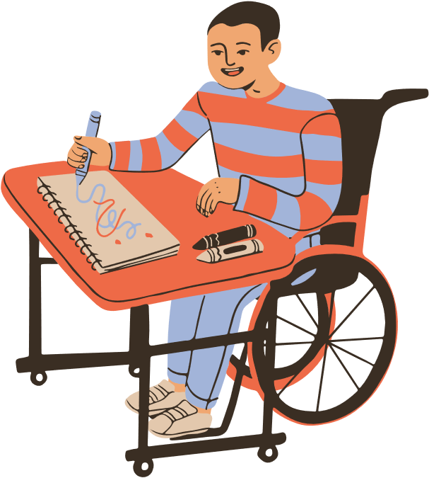
Creating Connections
Individual
Community
System

Slide 10
Usage Examples

Slide 11
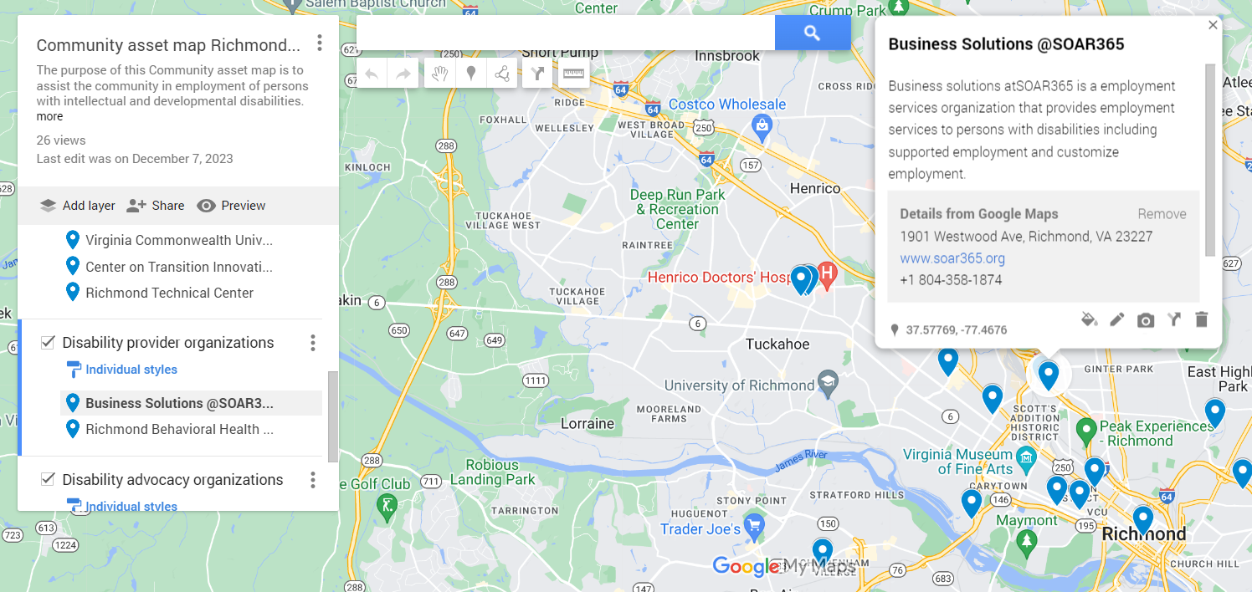

Division: Resource Location
My Maps
Notes:
Hyperlink to CC2 Infographic
Questions to ask participants:

Slide 12
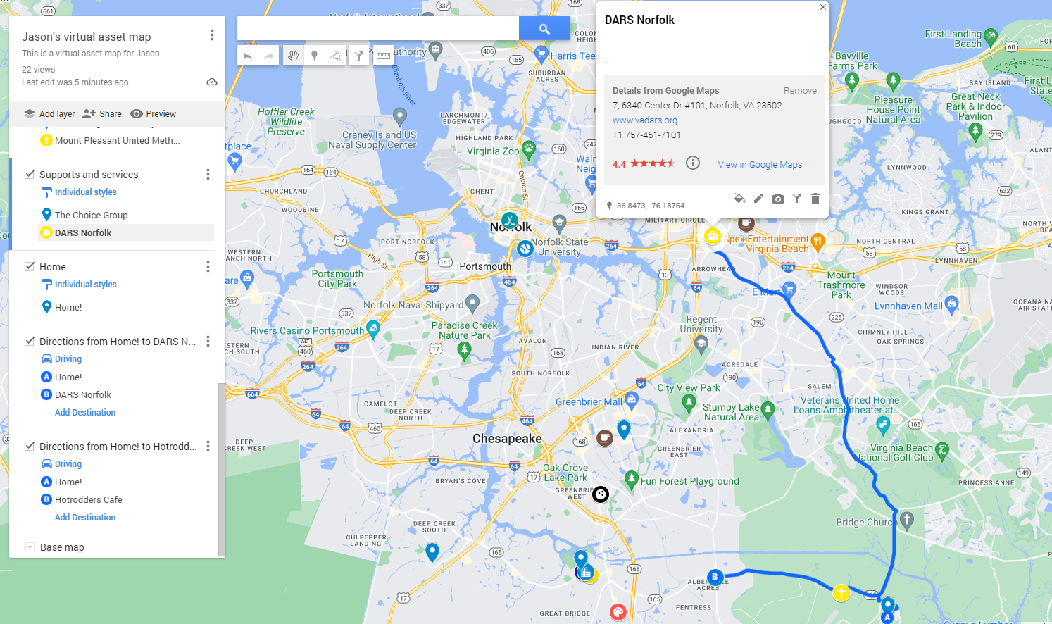
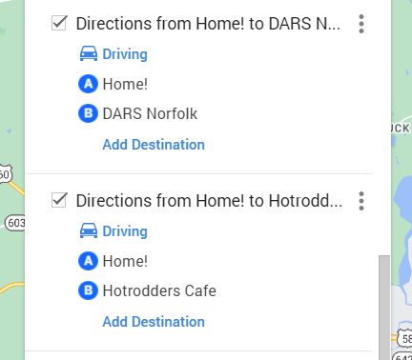
Division: Directions and Transportation

Slide 13
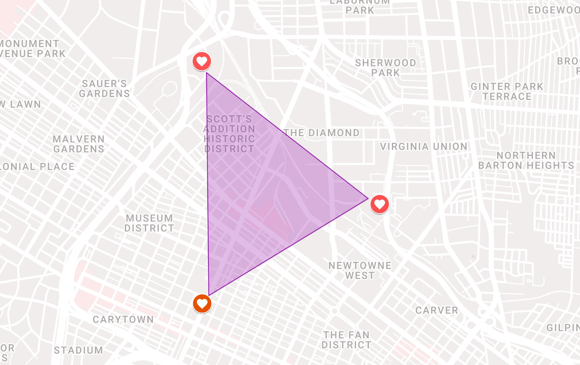
Division: Access & Disparity
Spatial Patterns
SPARC
Peak Experience-RVA
Project Yoga Richmond
Notes:
Seb

Slide 14
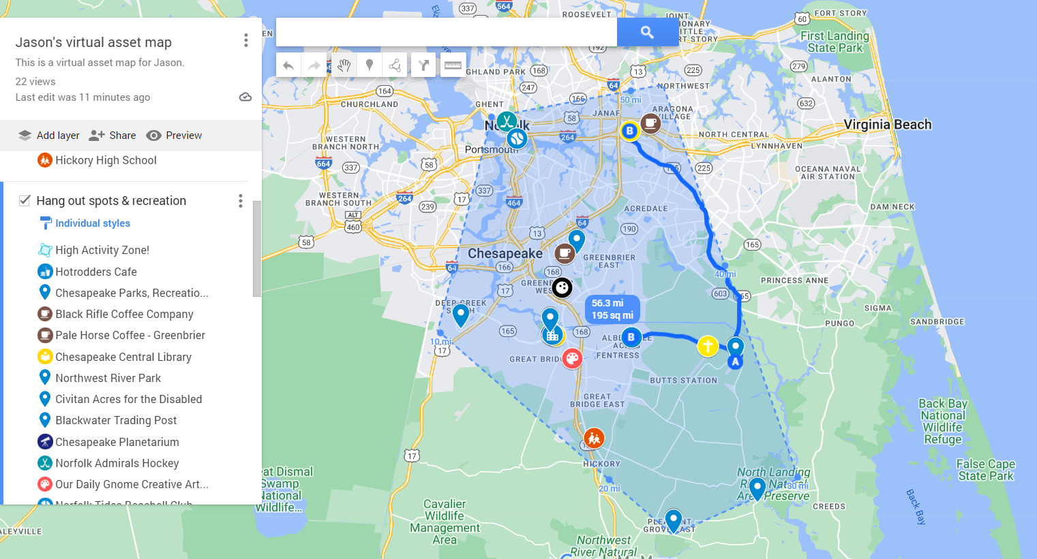
Student: Areas I can reliably travel
195 Square Miles

Slide 15
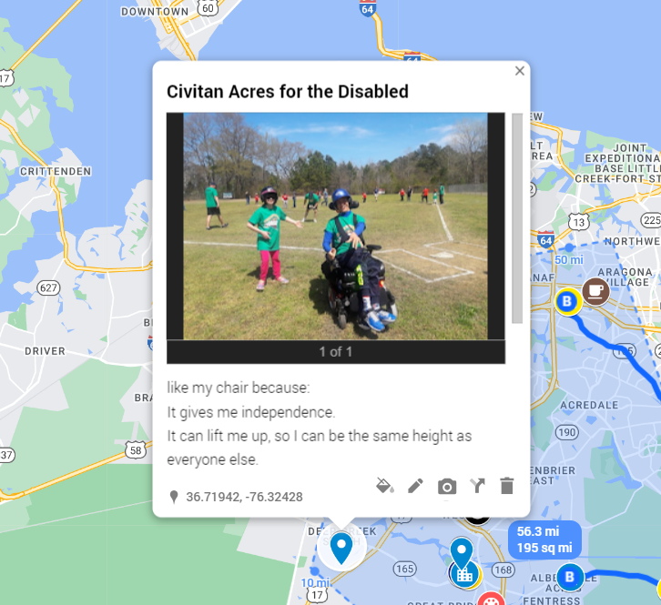
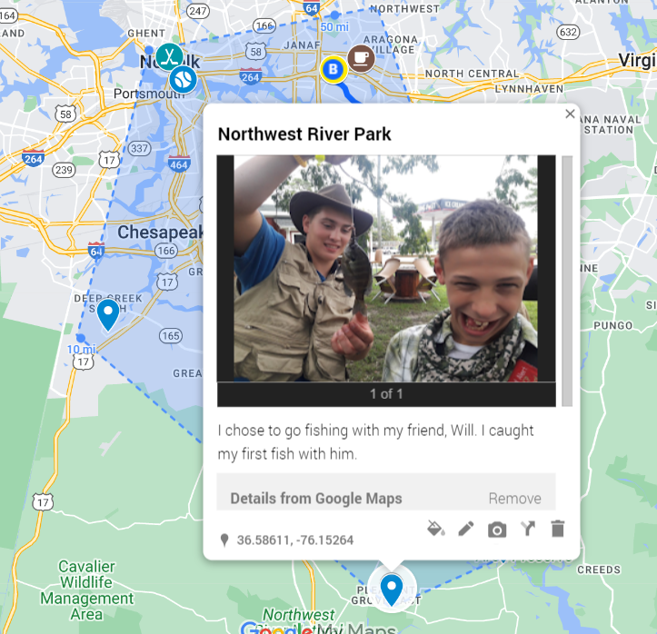
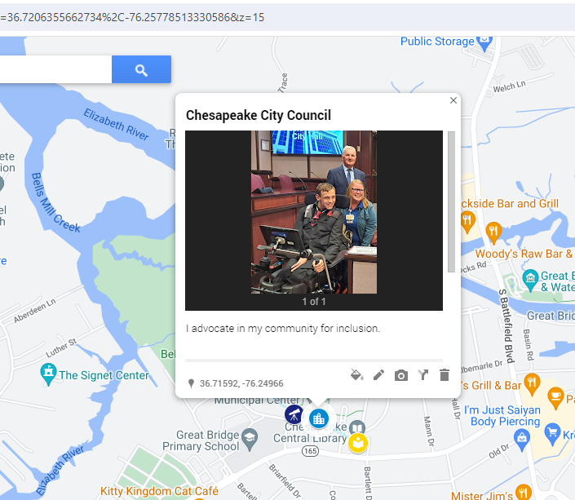
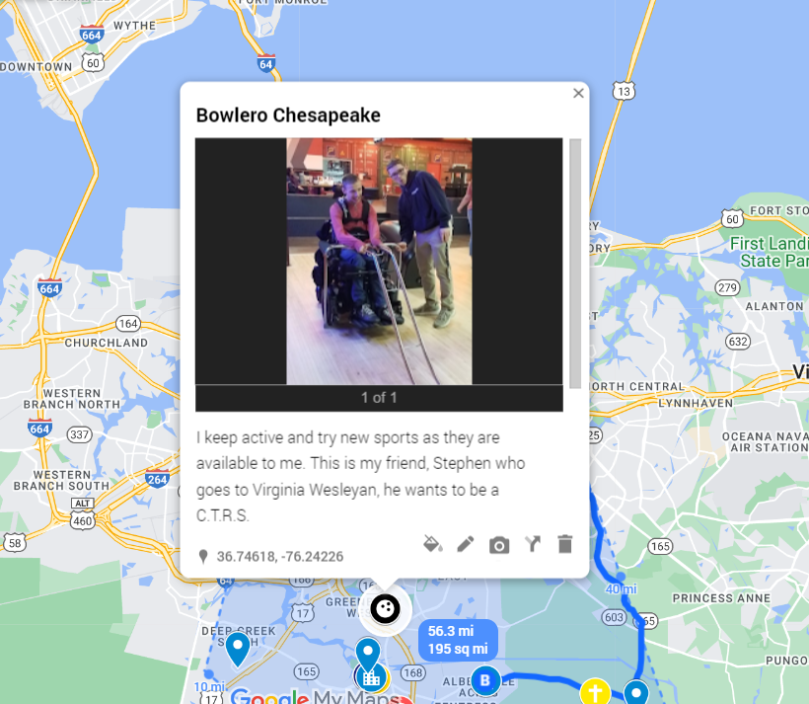
Student: Personalization

Slide 16
Pause for Reflection and Feedback
Given what we have talked about
  Do you see the value in virtual resource mapping?
  Do you think this is a medium that students and families would use?
What are you excited about with virtual asset mapping?
What are your concerns about virtual asset mapping?

Slide 17

Now the fun part: let’s map!!!

Slide 18

How do I begin?
Like most things, we begin at the beginning!
Individually, write what you think are your area’s three most important transition resources for students and families
Useful domains: Employment, postsecondary education and training, and community engagement
Notes:
Participants will make up a list of community resources of potential items to be added to a virtual asset map. Before breaking into small groups participants will shout out different examples of items that can be included on the map

Slide 19
Combine Resource Lists
Move into groups of 3-4
Talk about the resources on your list
Come to consensus around the top 5-10 resources
Write resources on poster paper and add symbols
$ - Employment
# - Postsecondary education and training
* - Community engagement
Notes:
3 minute brainstorming activity

Slide 20
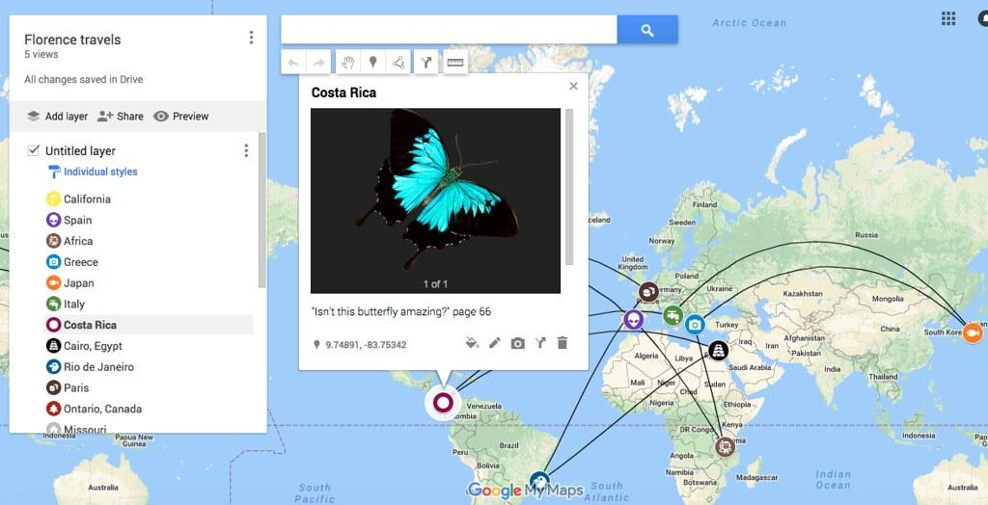
Orientation to Google my maps

Slide 21
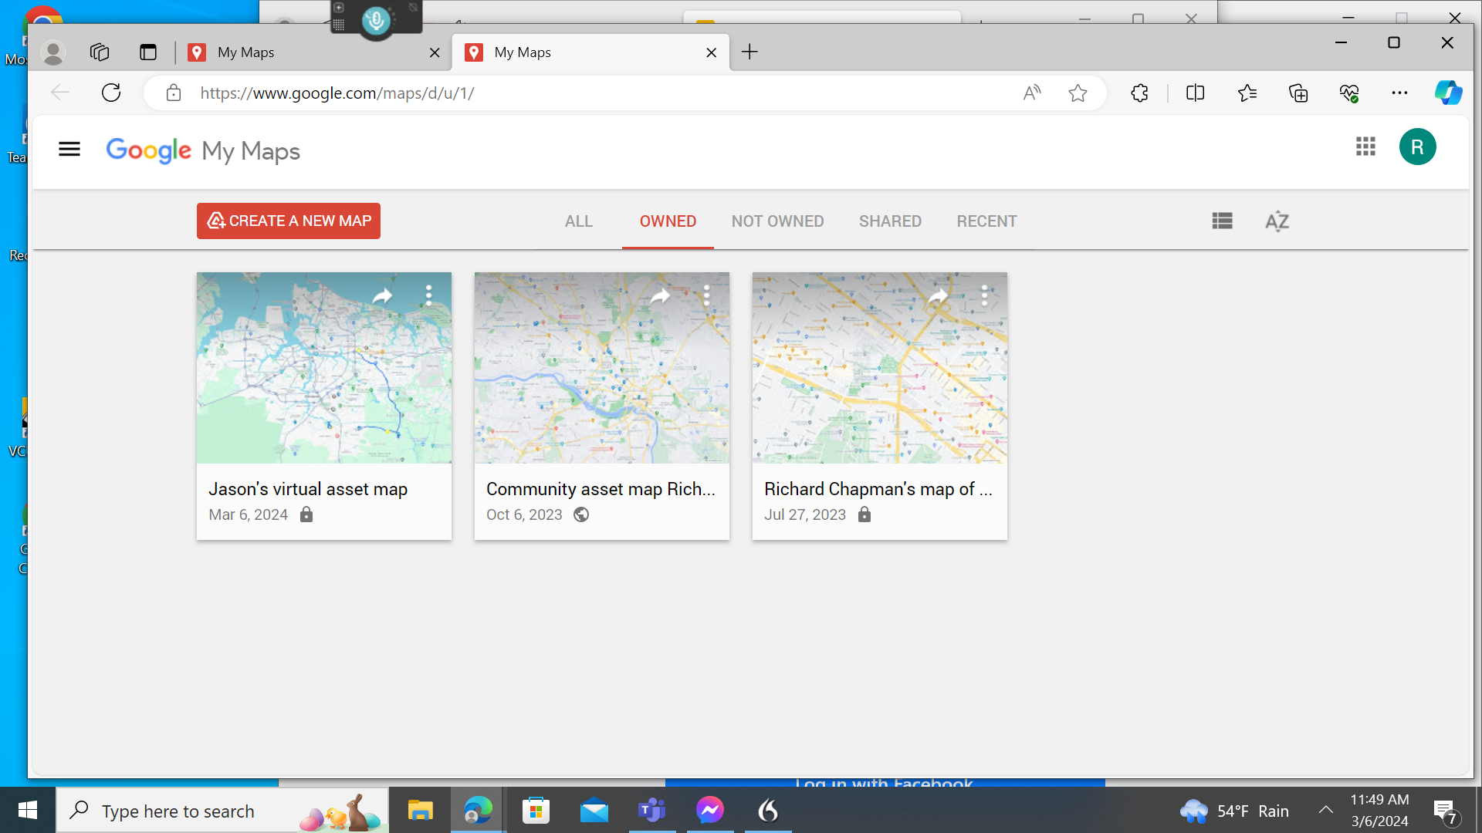
The Google my maps homepage

Slide 22
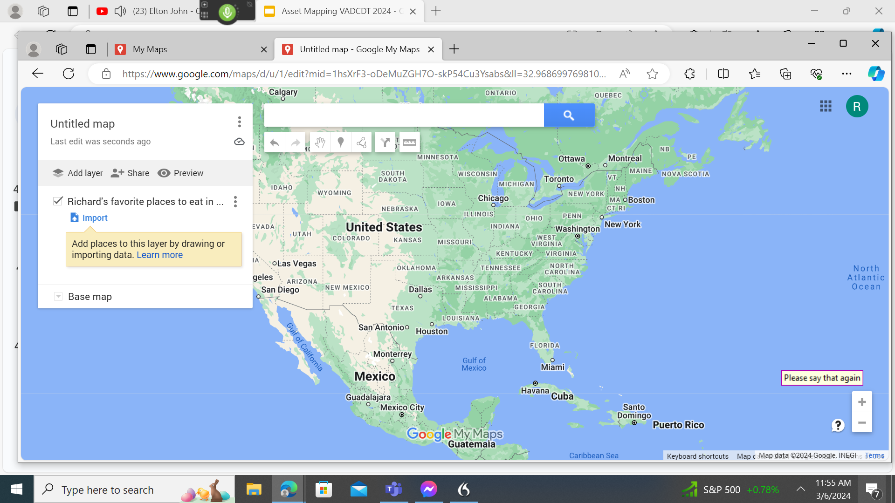
Add a layer to the map

Slide 23
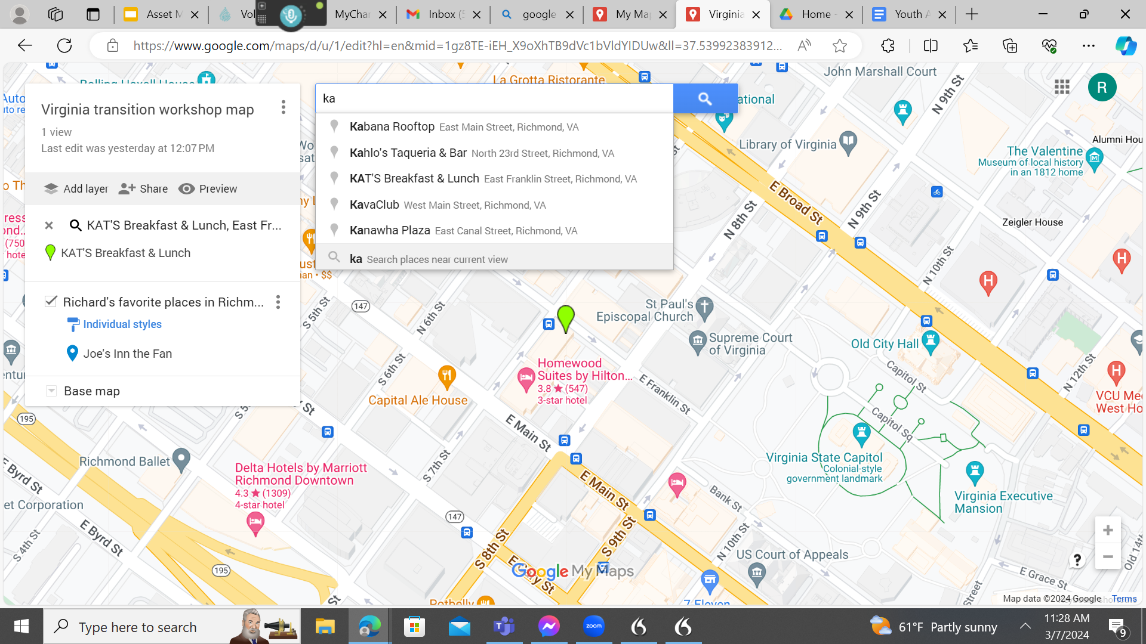
Adding a resource to the map

Slide 24

Resources
MAPS: https://www.mapstransition.com/
Inclusion Project: https://web.partnership.vcu.edu/InclusionProject/
Project PEACE: https://partnership.vcu.edu/programs/community-living/project-peace-community-collaborations-for-employment/

Slide 25
Thanks!
Do you have any questions?
Seb Prohn
smprohn@vcu.edu
Richard Chapman
chapmanra@vcu.edu
https://partnership.vcu.edu/

Slide 26
Funding disclosures
Project PEACE was supported in part by grant number 90DNCE0004-01-00, from the U.S. Administration for Community Living, Department of Health and Human Services, Washington, D.C. 20201.

