Slide 1
Welcome to the Colonial Heights Community Collaborative for Employment Transition

Slide 2
Why focus on Employment for persons with disabilities?
Everyone has something to contribute to the Workforce
Employment creates meaning for all people
A job is a human right
Persons with disabilities have the right to live, work and play in the community Of their choice, with the supports necessary to succeed. This is especially True for persons with Extensive support needs.

Slide 3
Setting the stage for today: What is the vision?
Community-based solutions For improved transition outcomes for persons with disabilities
Paid employment at or above minimum wage for all persons with disabilities. Including those with the greatest support needs.
Involvement of the whole community.
Employment is integrated and community-based

Slide 4


Slide 5

Solutions for Colonial Heights by Colonial Heights
Improve employment outcomes for youth with IDD
Wisdom and expertise of:
Youth with disabilities
Family members
School professionals
Business leaders/ entrepreneurs
Transition experts
Agency representatives
Employment service organizations
Advocacy organizations
Community leaders

Slide 6

Key Steps
Form a Community Collaborative for Employment Transition (That’s us!!)
Develop plans to make change
Implement plans with CHHS
Community landscape analysis
Colonial Heights strengths, opportunities, barriers & challenges to employment for youth with IDD
Information & resources for
Youth with IDD
Families
Businesses
Teachers & transition professionals

Slide 7
Consent Discussion
Purpose: to inform you of your roles and rights as participants
What is your role?
What should you know about your rights as participants?
  Privacy
  Benefits and Risks
  Data Security
  Withdrawal from Community Conversations
  Approved by VCU IRB
  Compensation
To participate in Community Conversations, you need to give verbal consent.
Simply say “yes” as I ask each one of you if you would like to participate.
More detailed information is provided in the consent document you received via email. If you would like us to resend this document, please reach out to projectpeace@vcu.edu.

Slide 8

Gather & Share
Careers
Participation
Using conversations to guide our way

Slide 9

Community Conversation & Story Harvest
Recorded group conversations
Share wisdom and experiences
Let everyone share
Mix-up groups and address new topics
Harvest/report exciting discussion
Meet new people
It’s a brainstorm!!

Slide 10
Conversation Etiquette
Speak your mind and heart
Link and connect ideas
Contribute your wisdom
Listen together for deeper understanding
Play & doodle on the whiteboard
Have fun!

Slide 11
ROUND 1
16 minutes
What can we do as a community to increase employment opportunities for youth with intellectual and developmental disabilities?
How can our community work together to make These ideas happen in Colonial Heights

Slide 12
ROUND 2
16 minutes
We know that employment is important for people with IDD and that employers benefit from having employees with IDD. What can we do to encourage more employers in our community to hire people with disabilities?
How can our community work together to make these ideas happen here in Colonial Heights?

Slide 13
Whole Group: Harvesting the Best Ideas
What are the most promising ideas that you have heard this evening?

Slide 14

Save the date
Next meeting
Location: TBD
Refreshments will be provided

Slide 15
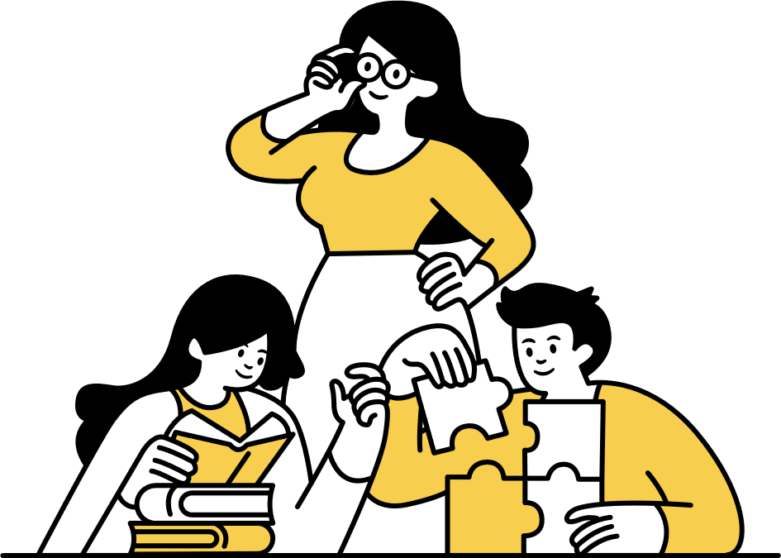
Evaluations
PLEASE help us strengthen our Community Collaborative for Employment Transition

Slide 16


Lingering ideas, thoughts, questions or concerns?

Slide 17

https://redcap.vcu.edu/surveys/?s=KMHF9YMND4LFJTFD

