Slide 1
Project PEACE Community Collaborative: Colonial Heights
February 6, 2025
6:00 PM - 8:00 PM

Slide 2
Meeting Agenda
Opportunities and Announcements
Focus on Community Voice
Overview of the Community Collaborative
Update on Colonial Heights Initiatives
Career Exploration: Novel Ideas
Break
Small Action Group Planning
Large Group Discussion and Report Out
Wrap Up and Next Steps
LaNeka

Slide 3
Opportunities & Announcements
Seb
Notes:
Seb: 10 minutes

Slide 4
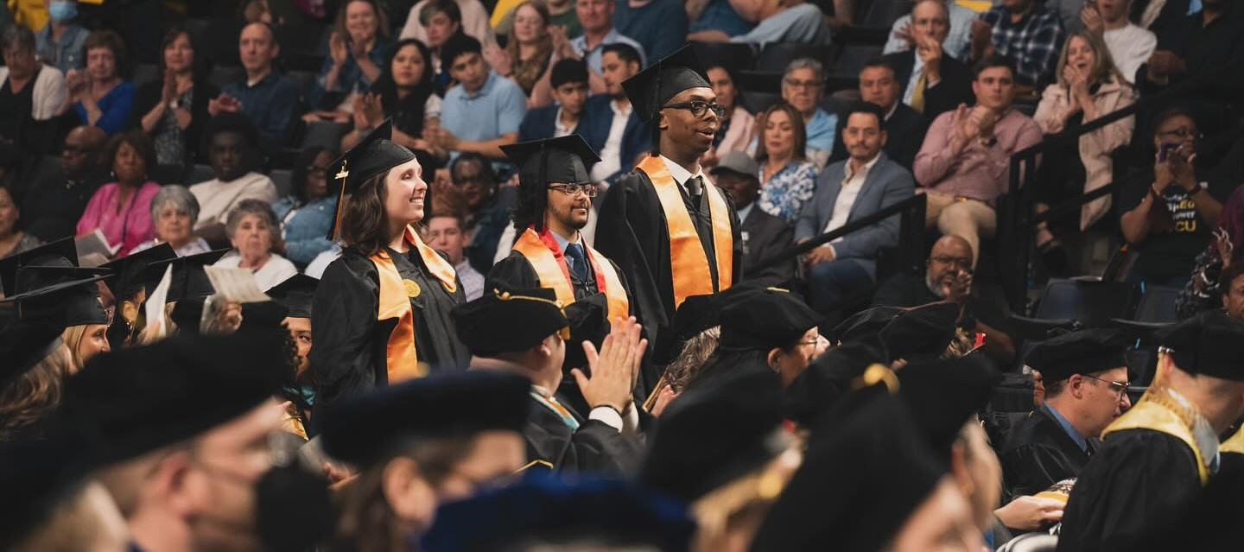

Opportunity for CH Students: ACE-IT in College at VCU is now accepting applications!
ACE-IT in College at VCU helps students with intellectual disabilities take classes, get paid jobs on campus, and obtain internships.
ACE-IT Graduates earn a Certificate from the VCU School of Education and have a 90% job success rate after completing this program.
Please Apply by February 15, 2025!
Eligible Applicants will be notified if they’ve been selected for interviews by March 2025.
Student selection will take place in April 2025.
For questions or more information, email aceit@vcu.edu
Seb

Slide 5



Center for Family Involvement Who are we?
  Parents and caregivers to family members with developmental disabilities and special health care needs
  Called Family Navigators or Family Mentors
  Possess a strong knowledge of local resources, services and the disability service system
  Diverse and aware of regional culture
  Trained through the CFI
Notes:
Family Mentors, also known as Family Navigators are diverse parents and primary caregivers currently or formerly providing support to a family member with a developmental disability or special health care need. Family Navigators are selected based on the possession of a strong knowledge of local resources, services, disability delivery system, as well as regional culture. Family Navigators are trained through the Center for Family Involvement at the Partnership for People with Disabilities at Virginia Commonwealth University

Slide 6
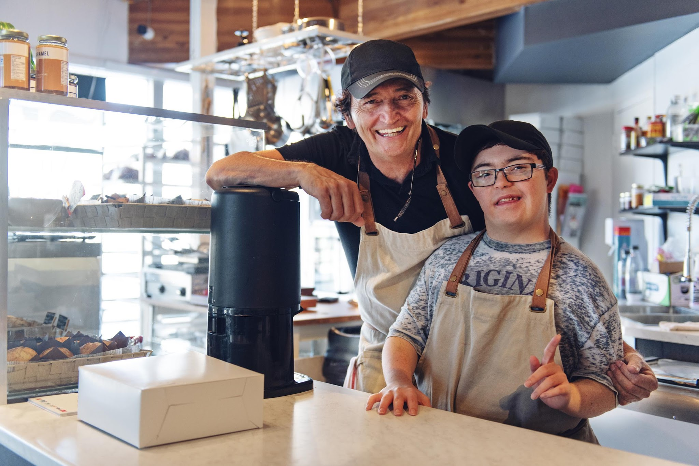


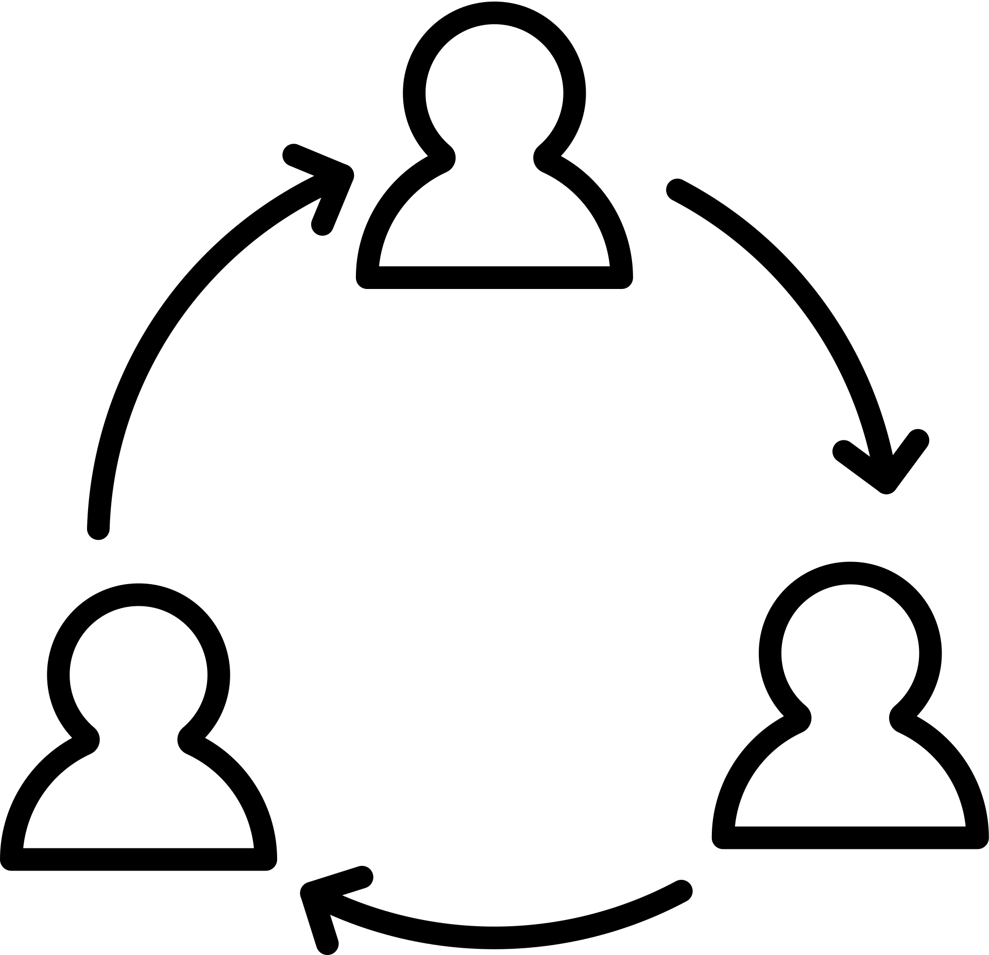

What kind of support an we provide?
Emotional Support
Referral Advice
System Navigational Support
Notes:
Family mentoring provides emotional informational and systems navigational support, and referral advice for family members of EPIC participants working to obtain and maintain Competitive Integrated Employment.

Slide 7




The Center For Family Involvement
1 ON 1
SUPPORT
ALWAYS
FREE
WEBSITE
FACEBOOK

Slide 8
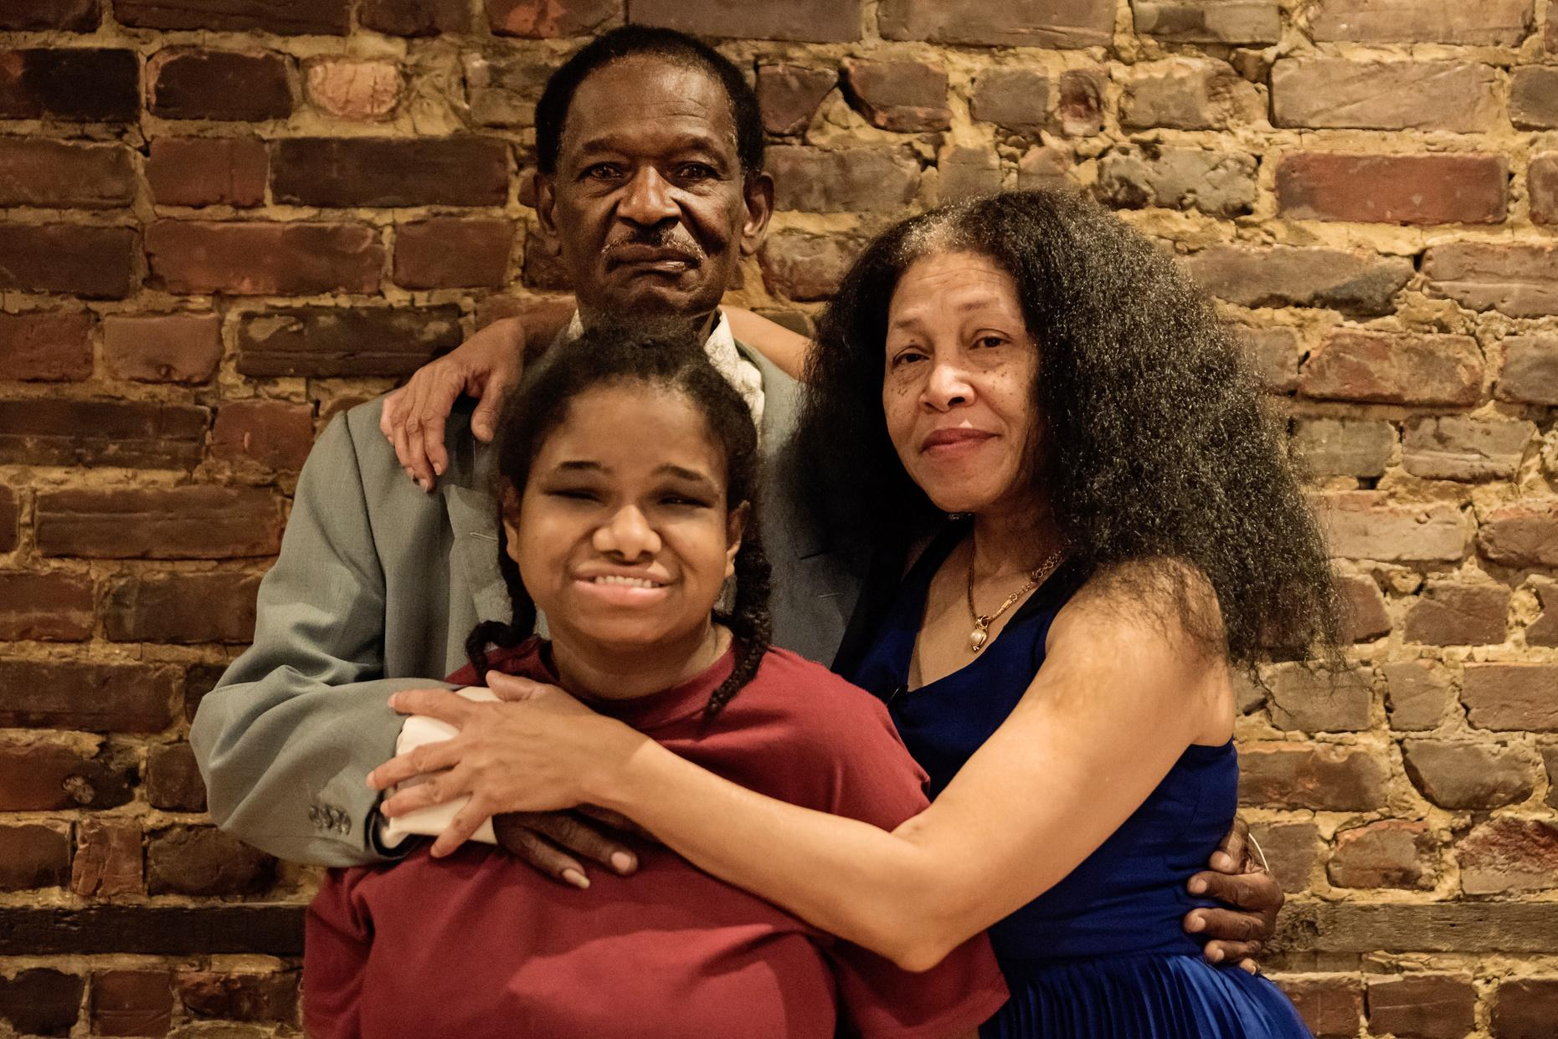

Why should I reach out to CFI?
Every family is appropriate for a referral. CFI Family Navigators offer the opportunity to talk to someone who has “walked in their shoes.” Family members may have specific concerns about:
Public Benefit Loss
Safety
The future
Capabilities
Notes:
Every family is appropriate for a referral. We know that family members of EPIC participants may have struggled in the past to understand how to access Competitive Integrated Employment or may be concerned about potential barriers to employment for their family member or may be overwhelmed by the vocational rehabilitation system. They may also have specific concerns about:
• public benefit loss while working
• issues of safety
• the individual’s ability to obtain employment that meets their needs and interests
• the possibility that the participant will experience failure
• whether their family member may be capable of working in CIE due to their disability.
A referral to a family mentor can provide an opportunity for the family member to talk with someone who has ‘walked in their shoes’ who can help demystify the VR system, direct them to resourced and help them prepare for team meetings to discuss and support their family member’s CIE.

Slide 9

How do Family Navigators provide support?
How much time is spent
with the family?
  Phone
  Text
  Email
  In Person
  They meet several times over a month or two
  As much as 8 hours of suppport
Notes:
Typically, family mentors talk with the family (by phone, in person) several times over a month or two period. The frequency and format is set by the family. Some families may feel supported after a couple of hours of mentoring while other families may continually seek emotional, informational and systems navigational support for months. Overall, we anticipate providing up to 8 hours of family mentoring for a family.

Slide 10

Focus on Community Voice
What was your first job or career opportunity?
Looking back, what was the value of your first job?
Richard
Notes:
15 minutes

Slide 11
Community Collaborative
Richard
Notes:
15 minutes

Slide 12

Purpose of the Community Collaborative
Apply your lived experience and perspectives to recommend activities and processes to improve transition to employment
Use your expertise of
  Colonial Heights
  Assets & Barriers
To develop a plan for community employment to be collaboratively reviewed and revised.
Support the implementation of the plan
Richard
Notes:
10 minutes

Slide 13
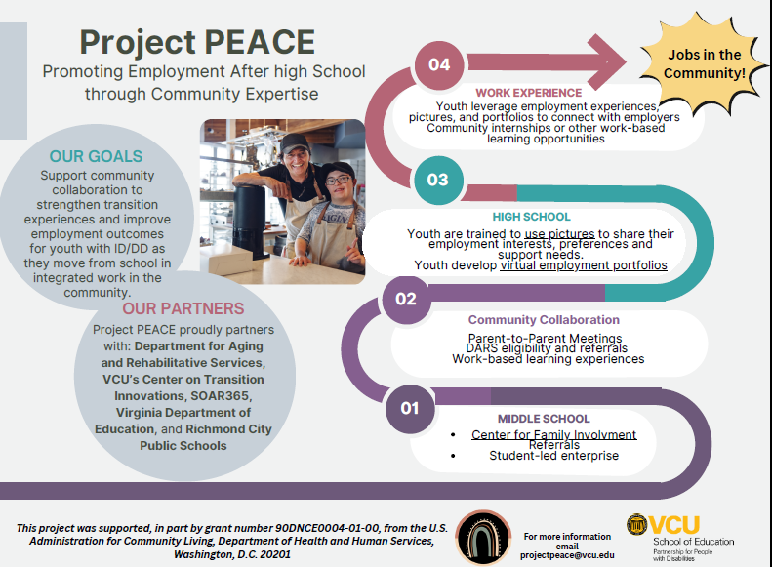
Seb

Slide 14
Recommendations from the landscape analysis
Employment supports for students
Expansion of work-based learning activities
Connection with CFI/DARS Pre–ETS navigators
Transportation communication- who covers employment transportation and under what circumstances?
Establishment of a community collaborative for employment transition
The development of a industry day event at the high school.
Students participating in on-the-job experiences
Richard

Slide 15
Colonial Heights Initiatives Update
Student-led enterprise: coffee cart
Work-based learning at the library
Connected with over 20 Colonial Heights businesses
Initiating work-based learning at Colonial Heights High School & hiring job coaches
Staff attending professional development at transition conferences
Detailed overview of coffee roasting process by a community business
Project SEARCH continues
Dan
Notes:
10 minutes

Slide 16
Career Exploration: A Novel Approach
Molly/LaNeka
Notes:
15 minutes

Slide 17
OUR PROCESS
WBL
PORTFOLIOS
A
B
C
D
PHOTOVOICE
Internship
Molly/LaNeka

Slide 18
PHOTOVOICE
Paired with WBL experiences
Designed to support those with the greatest support needs
Arts-based participatory research method
8 high school students in Intensive Support classroom participated in research
5 1-hour sessions including training and student interviews
https://drive.google.com/file/d/121wenf46HqNhuLS4UHdo7MxFYAh8MdYU/view?usp=sharing
Molly/LaNeka

Slide 19
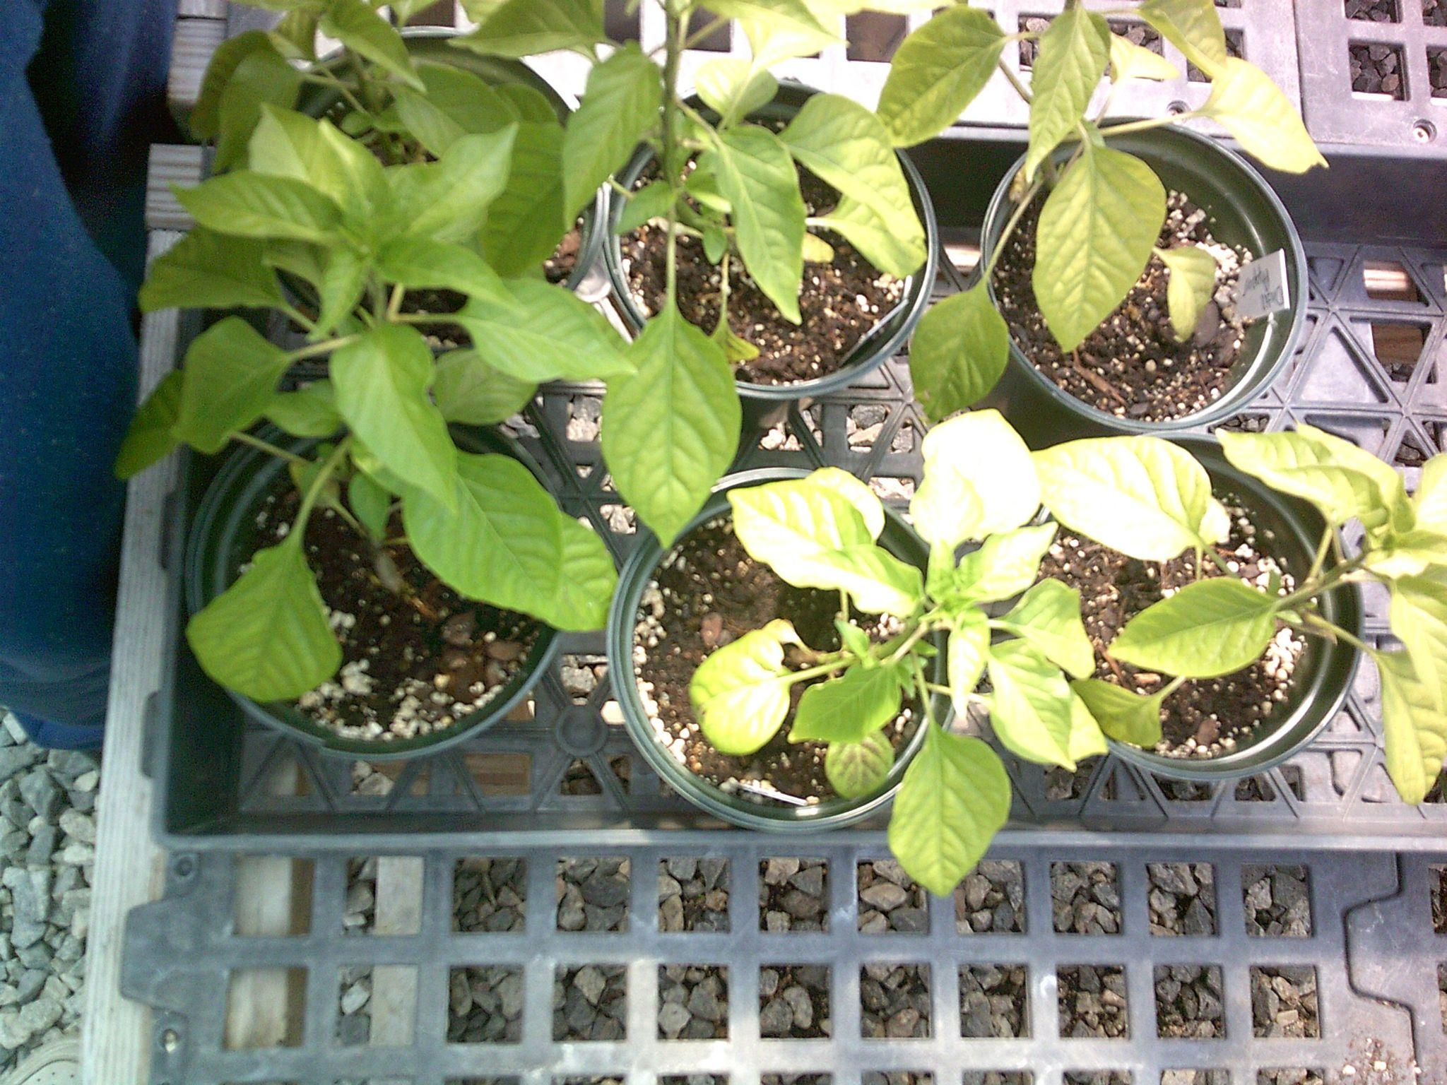
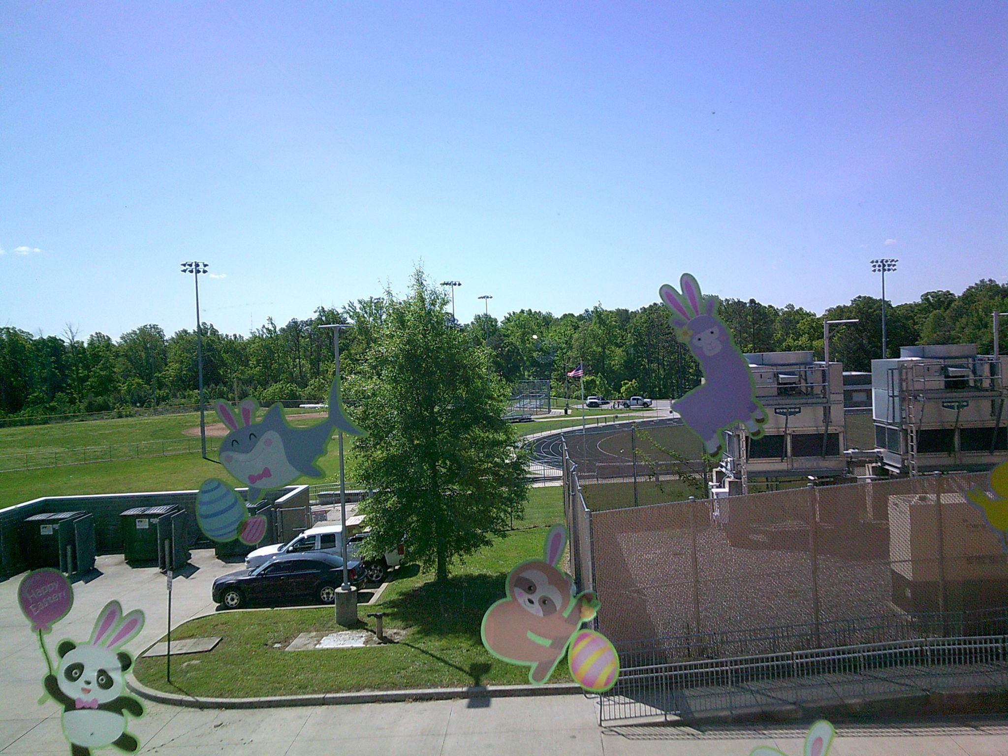
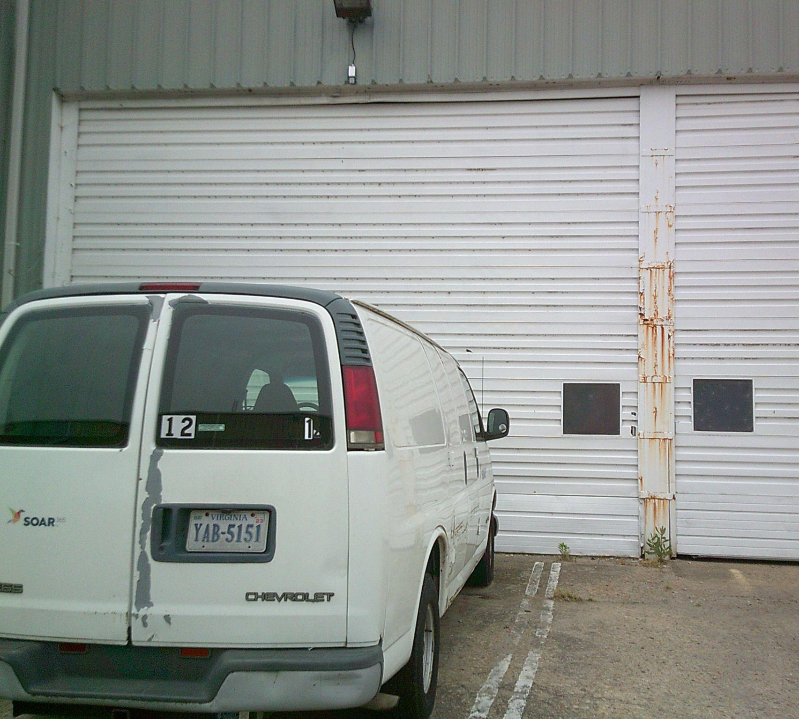
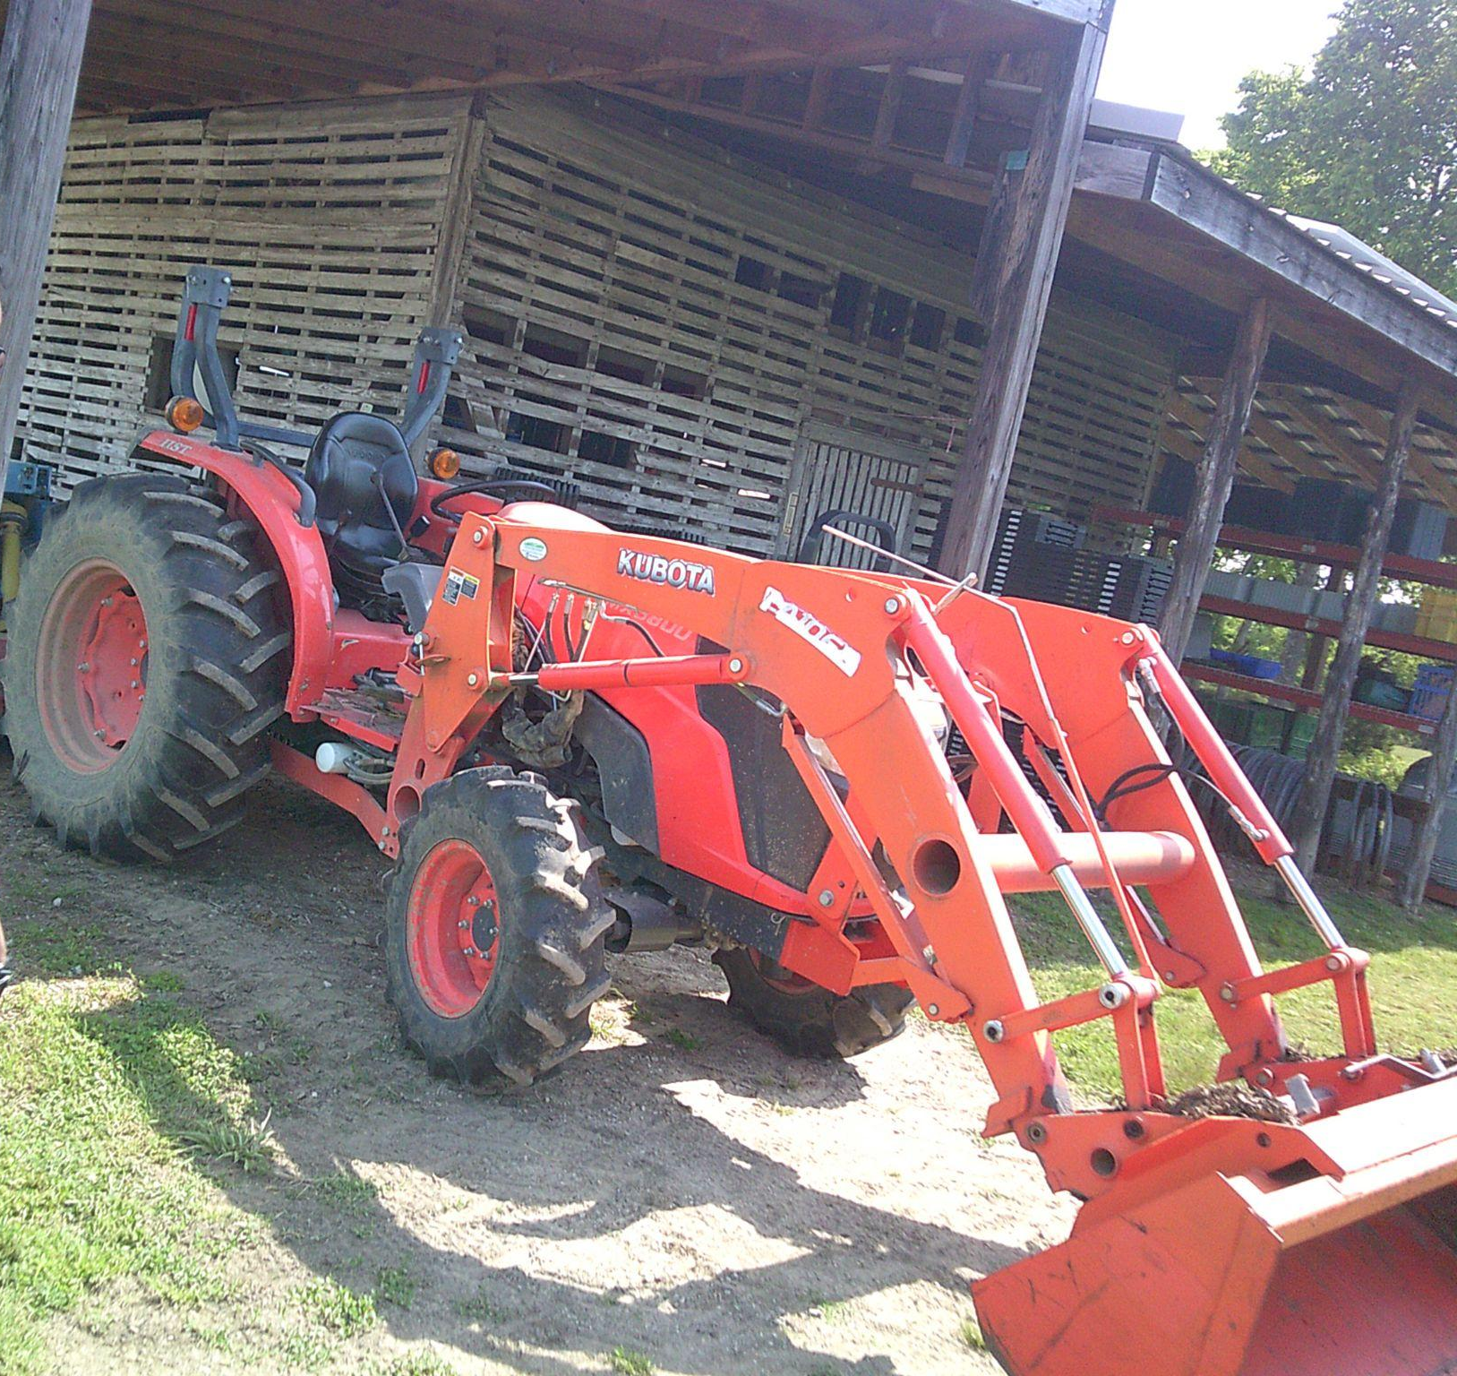
PHOTOVOICE OUTCOMES
Students’ explored and identified a wide range of employment goals and preferences including:
Landscaping
Art
Culinary Science
Pet Grooming
Truck Driving/Loading
And many more!!
Molly/LaNeka

Slide 20
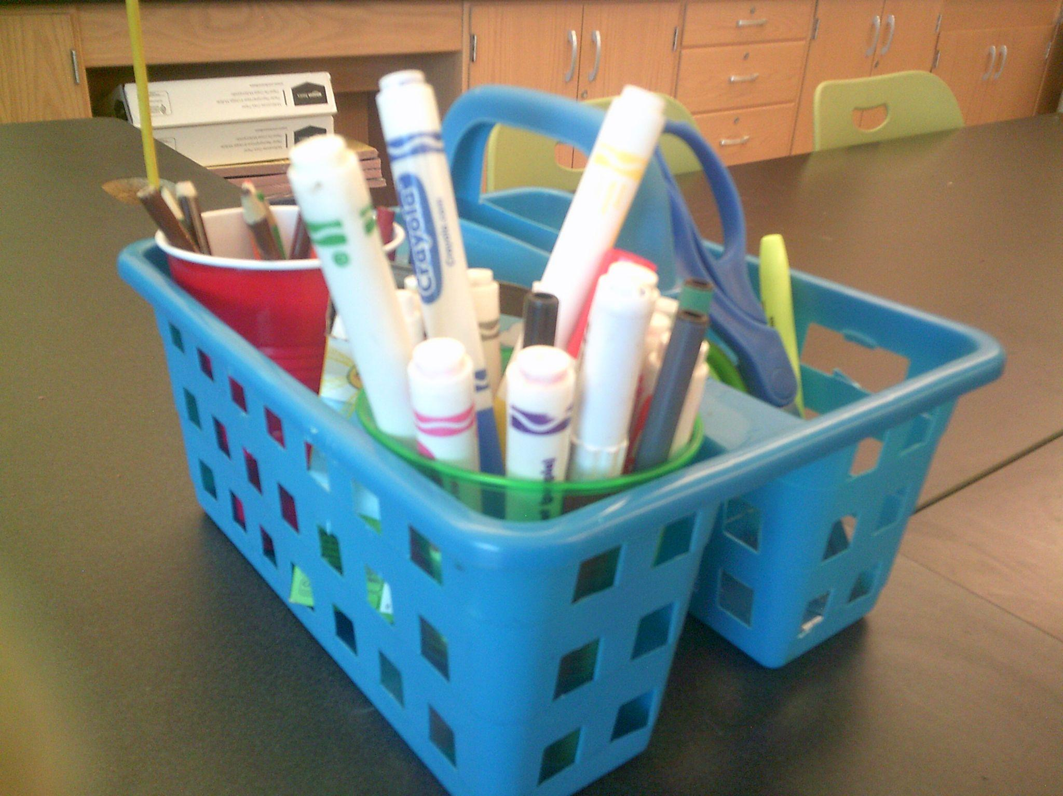
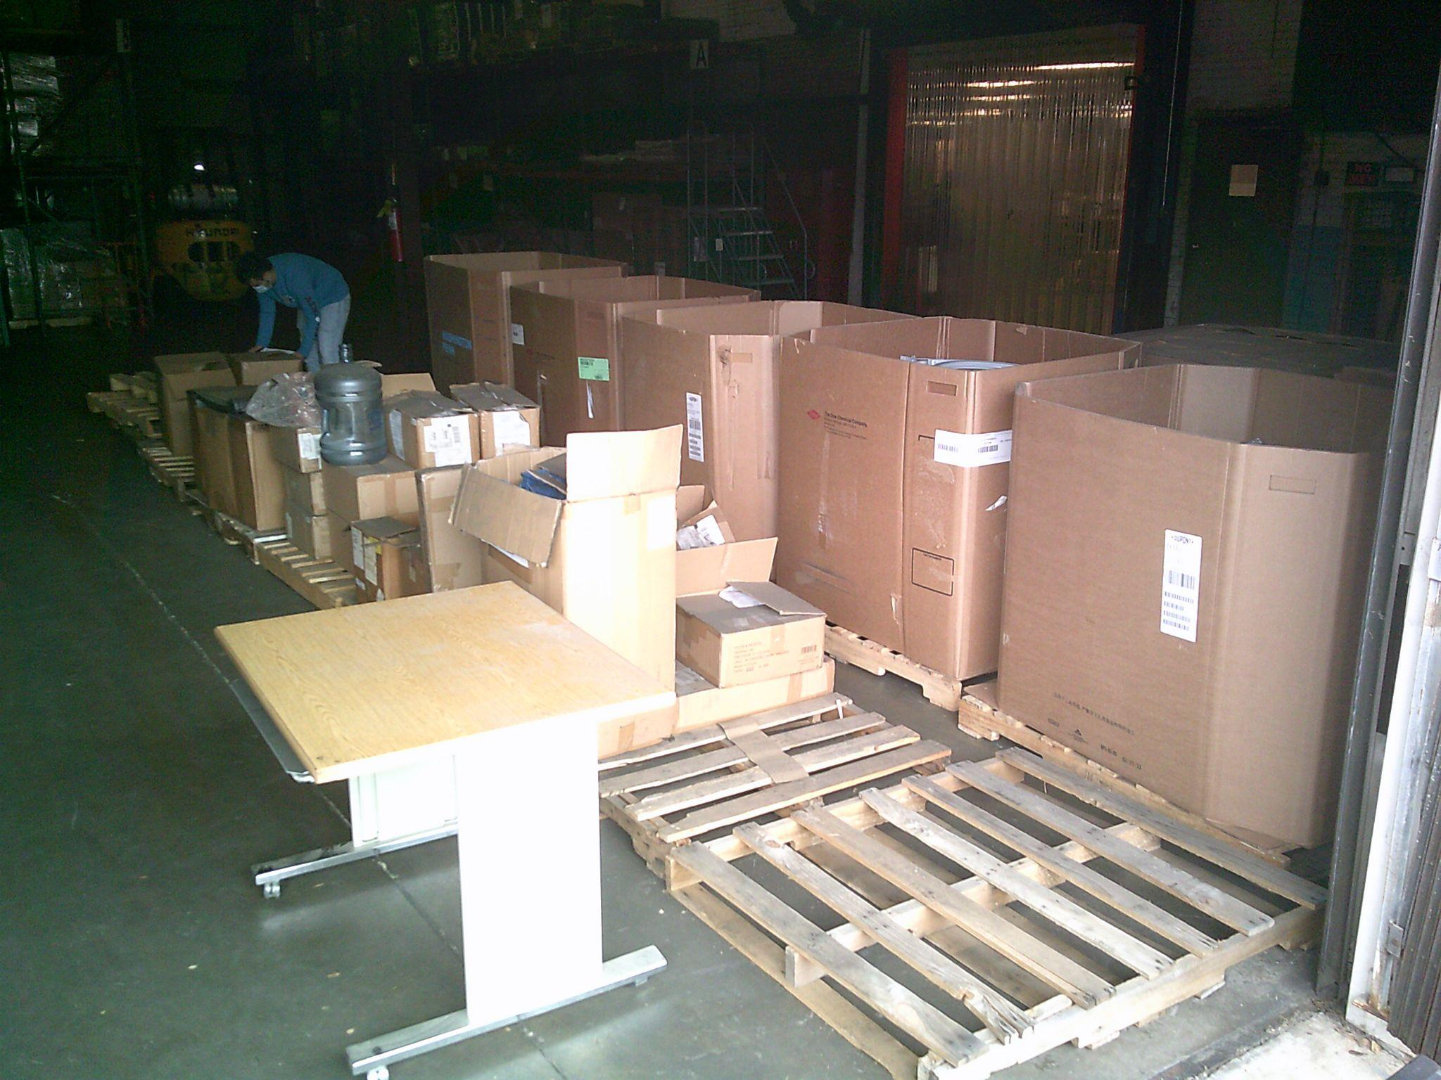
PHOTOVOICE OUTCOMES
Students took photographs related to their employment goals and experiences.
All students communicated their work goals, preferences, and accommodations through discussions around photographs.
Molly/LaNeka

Slide 21
DIGITAL PORTFOLIOS
Leveraging photovoice to create a transition & employment tool
Google Classroom & Google Sites
Molly/LaNeka

Slide 22
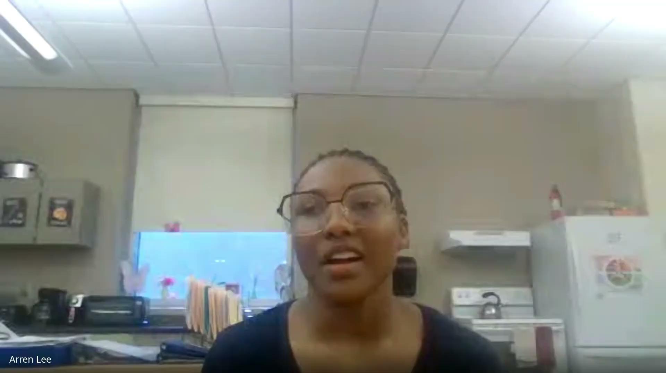
VIRTUAL STUDENT PORTFOLIOS!
Molly/LaNeka

Slide 23
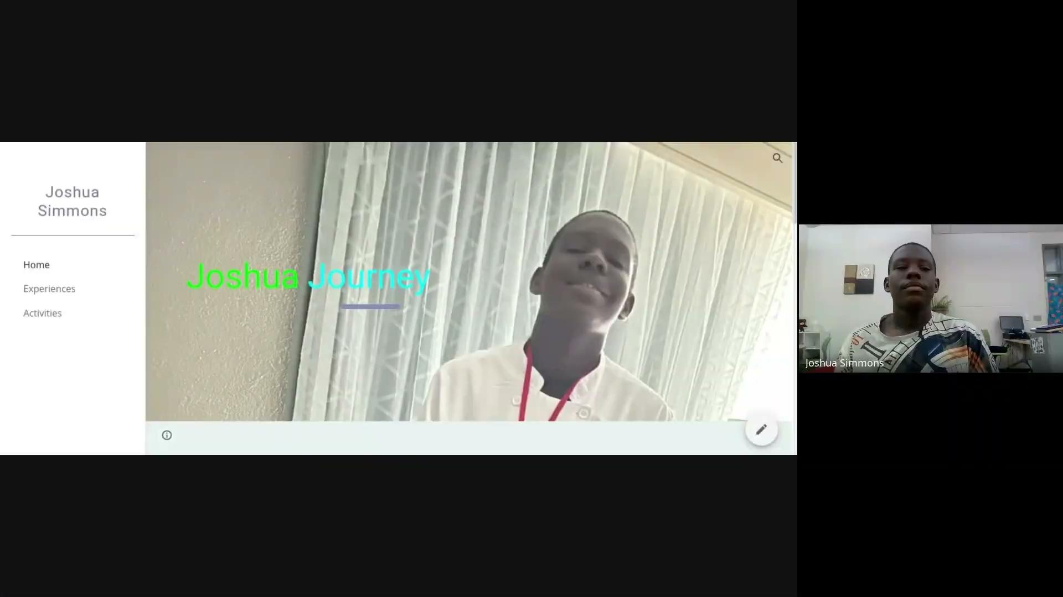
VIRTUAL STUDENT PORTFOLIOS!
Molly/LaNeka

Slide 24
STUDENT-LED RESEARCH & TRANSITION
IMPLICATIONS
HOW TO LEVERAGE PHOTOVOICE AND PORTFOLIOS
Molly/LaNeka

Slide 25
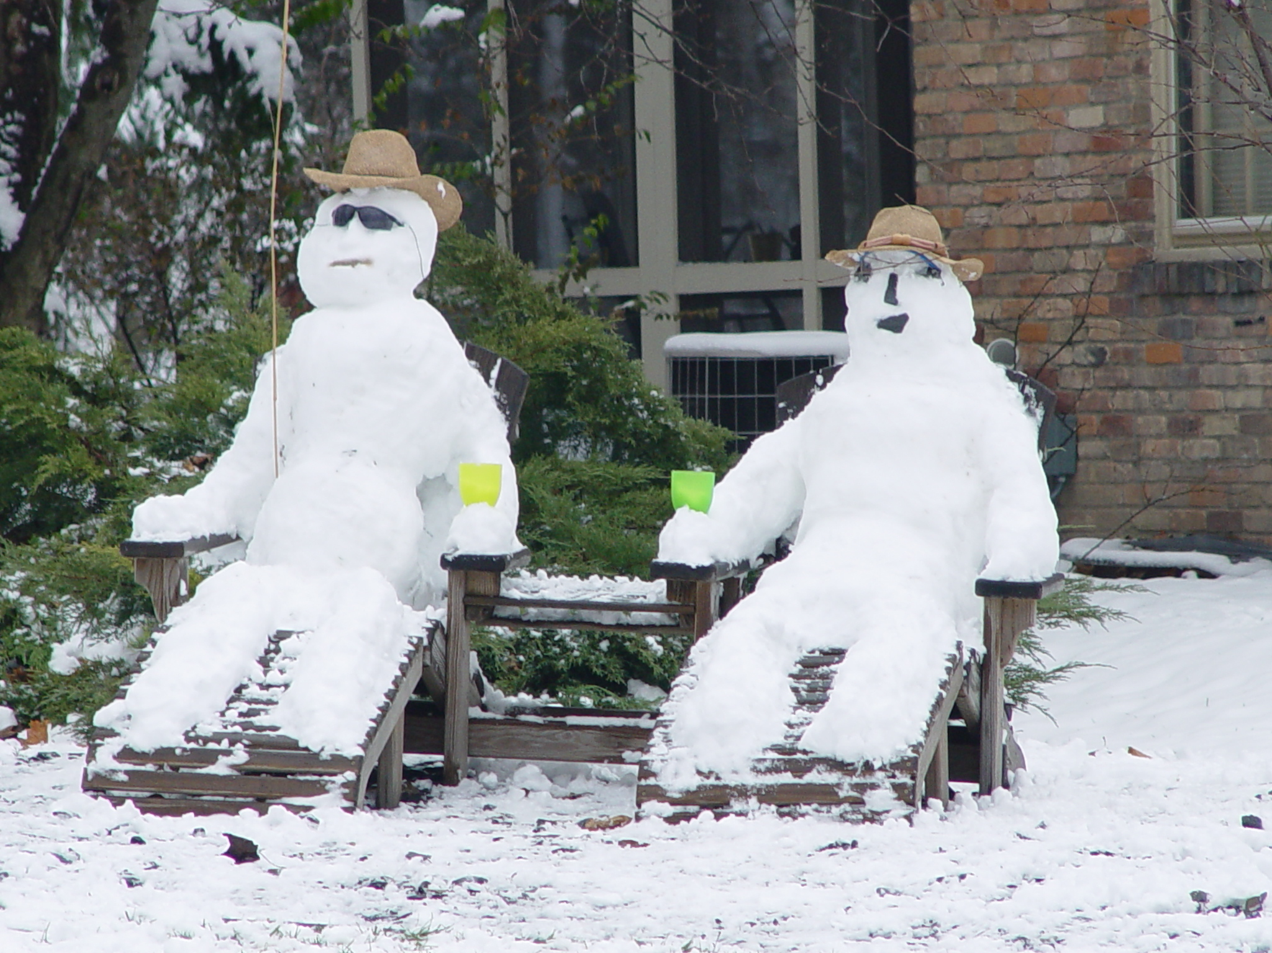
Break Time!
Please grab more food and/or revisit our gallery walk. Share your thoughts on these images if you haven’t had the opportunity!
Notes:
5 minutes

Slide 26
Small Group Action Planning
Action Planning Steps
Sample Transition Activities
With your group…
Step 1: Select transition activities that will best lead to employment outcomes.
Step 2: Why these activities & this order? Outcomes?
Step 3: How would you order your activities (1 - X)?
Step 4: What steps need to be taken to make this a reality?
Visiting community businesses to learn about jobs and job tasks
Photovoice, virtual portfolios, virtual mapping to track/reflect on employment experiences
Chores and volunteering in the home and community
Internships
Industry days/job fairs
Summer employment
Parent support and training (pre-ETS, DARS, benefits)
Student-led enterprise in middle school
Other
Seb
Notes:
20 minutes

Slide 27

Large Group Idea Harvest
Notes:
20 minutes

Slide 28

Wrap-Up and Next Steps
Community Landscape Analysis forthcoming
Next meeting is May 1: activities, goals, timelines
Monthly newsletters
Remember: ACE-IT deadlines & Center for Family Involvement parent to parent support
Richard
Notes:
10 minutes

Slide 29
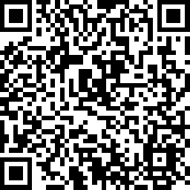
Feedback!
PLEASE complete the survey in the QR code to help us strengthen our Community Collaborative

Slide 30
THANKS
Do you have any questions?
Please email the Project PEACE Team
projectpeace@vcu.edu
Our next meeting will be May 1, 2025!
Please see LaNeka for your Payment!

