Slide 1

Transition Landscape Analysis:
Investing Community in Plans to Improve Employment Outcomes
Seb Prohn, Ph.D.
Molly Taylor
Partnership for People with Disabilities
Virginia Commonwealth University

Slide 2
This project was supported, in part by grant number 90DNCE0004-01-00, from the U.S. Administration for Community Living, Department of Health and Human Services, Washington, D.C. 20201.

Slide 3
Project PEACE: Promoting Employment After high school through Community Expertise
Our Values
Leading our research are people of color and people with disabilities
Rooting conversations in lived experiences of our community members
Research Methods
Review of secondary data
Community Conversations*
Photovoice*

Slide 4
Today’s Workshop and Presentation
1
2
3
Community involvement in transition
What is a Landscape Analysis?
Secondary Data Analysis & Review
4
5
6
7
Business Needs
Community Conversations
Photovoice
Takeaways and future steps

Slide 5
What is the community’s role in developing employment solutions?
Businesses
Community Program Leaders
Educators
Transition Services Providers
Youth and their Families

Slide 6
What is a Landscape Analysis?
Multi-method research approach
Customized to your research objectives
Understanding context

Slide 7


Distinguishing Community Landscape Analysis
Community-based, participatory methods
Action

Slide 8
What is “community-engaged research” to you?
Notes:
Have conversation with the audience to hear their thoughts behind conducting community-engaged research

Slide 9


What definition of community-engaged research do you most strongly agree with?
ⓘ Start presenting to display the poll results on this slide.
Notes:
📣 This is Slido interaction slide, please don't delete it.
✅ Click on 'Present with Slido' and the poll will launch automatically when you get to this slide.

Slide 10
How many different groups of people can you think of that you would like to see take part in employment and transition planning?
Now, let’s brainstorm how you would invite each of these groups to participate in planning. What are some strategies that you can think of?

Slide 11
1
Secondary Data Review and Analysis

Slide 12

Strategies for finding sources
1. Build a team with varying strengths and knowledge
2. Reach out to research and community partners for documents, reports, and papers
3. Look in unexpected places (school division websites, appendices in other reports, ect…)

Slide 13
How does this set us up for our next steps?
Gives an idea of existing resources
Finding community partners to work with
Helps us know what questions to ask

Slide 14
Challenges & Strategies
Relevance to Your Community
Synthesis Across Sources
Many reports include statewide data
Literature often doesn’t include participants from your community
Find themes to take away, and think about how they manifest in your community
Several sources spanning decades, not all reporting on the same metrics
Focus on their conclusions and next steps

Slide 15
2
Business Needs

Slide 16

Mending Gaps in Business Connections
Step 1
Step 2
Step 3
Step 4
Aligned Missions
Networking
Business Needs
Solutions

Slide 17
Not knowing how to connect
20 employees
Most frequent barrier to hiring people with IDD
Creating a disability friendly climate Improving accessibility | Developing internships Financial and tax incentives
Learning Interests
Average company size

Slide 18
3
Community Conversations

Slide 19
Method
1. Recruitment
  Who do you ask to participate?
  How do you encourage people to register?
2. Format of sessions
  What works best for your community?
  How do you make participation inclusive and equitable?
3. How do you introduce these conversations?
  Centering the voices of youth with IDD and their families
4. Questions to ask
  What questions would you want to ask community stakeholders?
5. Evaluations following sessions
  Evaluate the efficacy of each conversation
  Responses from participants and research team

Slide 20
“I really enjoyed this morning, how we opened up the session with individuals telling their story”

Slide 21
What do sessions look like?
Ice breaker activity
Introduction
Explaining our objectives
Consent discussion
Sessions 2, 3, 4… include some member checking
Small breakout groups: about 20 min of discussion around 1-2 questions
Whole group transition time/break
Small breakout groups: change up group members
Whole group “harvest”
  “What are the best ideas you’ve heard tonight?”
Conclusion- invitation to next session

Slide 22
Qualitative Data Analysis
Barriers to Employment
Solutions for Employment
Changing attitudes/mindsets
Accessibility
Lack of Resources
Supporting Youth
Supporting Employers
Attitudes/Mindsets
Using Technology
Supporting Educators

Slide 23
Qualitative Data Analysis
Supporting Employers
Education
Partnerships/
Relationships
Mentorship

Slide 24
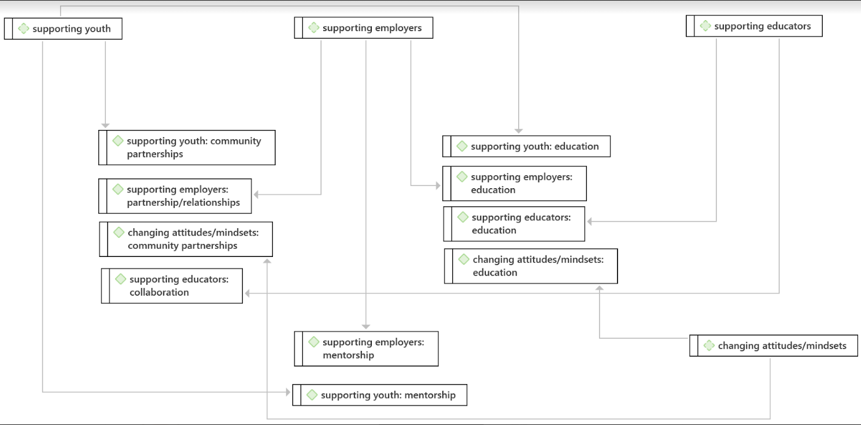
Preliminary Results CC1

Slide 25
Preliminary Results
“But important thing is even with disabilities, such as autism ADHD, ADD, you have to stay focused, you have to stay calm, you will get nervous in the interview, but you gotta look at them. You can't take your attention away from the interviewer. Otherwise that's how they know they won't hire you.”
“All the complicated stuff that parents have to sort of pretty much run into by mistake because like was pointed out earlier, there's not a centralized place for resources. There's no one, you know, navigation tool or map. And so every family has to like kind of figure these things out for themselves”

Slide 26
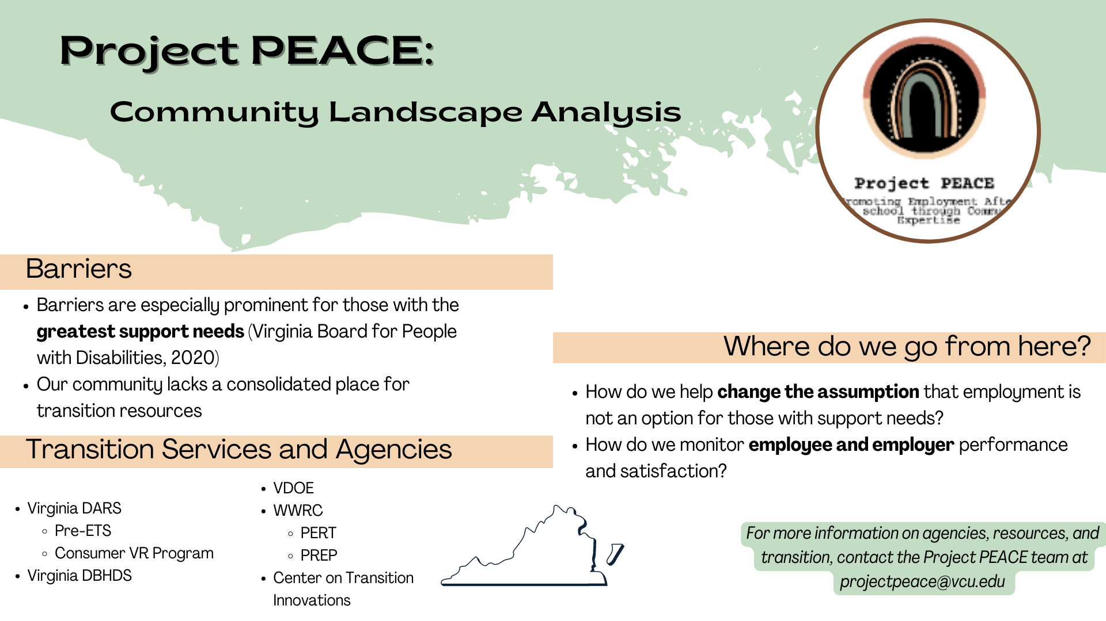

Slide 27
Infographic of Session 1 for Validation

Slide 28
Challenges & Strategies
IRB Approval
Recruitment
Communicate with IRB reviewers EARLY
Consent process: how to recruit a diverse group of participants
How much time does it take?
Partnerships and relationships are essential
Don’t be afraid if the sessions are small

Slide 29
4
Photovoice

Slide 30
Method
Recruitment
  Collaborating with community partners
  How long is a realistic recruitment timeframe?
Format of sessions
  6 sessions total
Important things to keep in mind
  Making sessions engaging and interactive
  Who is leading these sessions?
  Is there someone present who youth trust?
Questions to ask
  What questions would you ask for your community research?

Slide 31
Photovoice Sessions
1
2
3
4
5
6
Registration Meeting
Answering Questions
Parental Consent
Project Overview
Consent Discussion
Telling Stories
Camera ethics
Taking a good storytelling picture
Small Group Discussion
~20 Minutes
Whole Group
Next Steps of Project
Taking quality pictures
SHOWeD Questions
Introduce Topic 1
Small Group Discussion
~20 Minutes
Introduce Topic 2

Slide 32
Qualitative Data Analysis Approach
Similar to Community Conversations Analysis
Start with larger themes as “Code Groups”
Inductively code segments into smaller codes
Create more specific “subcodes”

Slide 33
Challenges & Strategies
Researcher-Participant Trust
Engagement
Collaborate with community leaders for recruitment
Hold live information sessions with participants and parents
Make training sessions into discussions
Ask participants about their interests

Slide 34
Catering Landscape Analysis to your Community

Slide 35

Which part of the landscape analysis process do you anticipate to be the most challenging?
ⓘ Start presenting to display the poll results on this slide.
Notes:
📣 This is Slido interaction slide, please don't delete it.
✅ Click on 'Present with Slido' and the poll will launch automatically when you get to this slide.

Slide 36

How do you know where to hold group sessions?
Virtually?
In-person?
How Long?
What Time?

Slide 37
Other Research Methods
Virtual Asset Mapping
  Where are transition resources in your community?
  Are there barriers to accessing these resources?
Quantitative Designs
  Incorporating evaluation into qualitative research
  Community members rating proposed plans
  Needs surveys

Slide 38
What are some of your questions or concerns about conducting a community landscape analysis?

Slide 39
Thank You!
Feel free to reach out and follow along through these platforms:
@projectpeace@vcu.edu
@smprohn@vcu.edu
@taylorml9@vcu.edu
@ProjectPEACE_VA
@projectpeace_va

